Slide 1

LaunchFamily
AI Parenting Platform
Media Kit

Slide 2




Introduction
About LaunchFamily
AI-Powered Parenting
LaunchFamily uses AI through Emmie, an emotionally intelligent assistant that helps parents manage routines, meal plans, and playdates effortlessly.
Expert Network
Access a curated network of therapists, coaches, educators, and pediatricians offering trusted advice and 1:1 support for families.
Smart Tools
Personalized routines, allergy-safe meal plans with grocery lists, document scanning, behavioral coaching, and a private family dashboard.
Emotional Guidance
Combining AI insights with human empathy, LaunchFamily supports parents emotionally to reduce overwhelm and build confidence.

Slide 3
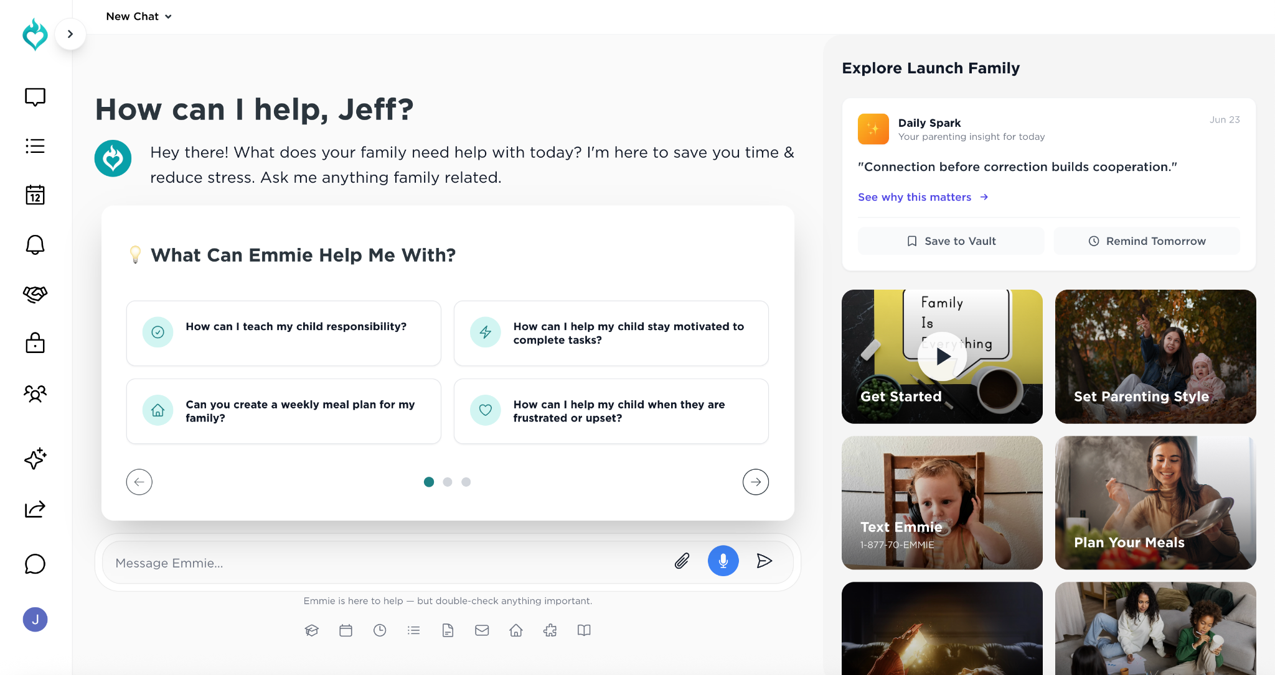
Overview
Founded in 2025
Target Audience: Millennial + Gen Z parents
Emmie leverages GPT-based intelligence and expert-backed training
Revenue model: Parent subscriptions (~$12/month), Expert SaaS ($30–$100+/month), Commissions
LaunchFamily Podcast: Recorded over 40 episodes with parenting experts
Fast Facts

Slide 4
Audience
Who We Serve
Parents
Experts
New parents seeking guidance to reduce overwhelm
Families managing neurodiversity with tailored support
Busy parents juggling multiple children, work, and stress
Looking for reliable, accessible parenting tools and advice
Parenting coaches expanding their reach through digital tools
Therapists providing specialized emotional and behavioral support
Pediatricians offering expert medical advice and guidance
Professionals seeking scalable, AI-enhanced practice solutions

Slide 5
Mission & Vision
Mission
Our Mission
Empower families with smart, trusted parenting tools
Help parents feel more connected and capable
Reduce feelings of isolation in modern parenting
Combine AI technology with expert human guidance
Our Vision
Become the global go-to platform for parenting support
Earn trust through both AI and human expert collaboration
Transform the future of family care worldwide
Support diverse families with personalized, accessible solutions

Slide 6
Flywheel
Our Flywheel Model
Experts Share Trusted Advice
Parents Engage with AI + Tools
Content Builds Trust + Reach
More Experts Join + Monetize
Data Makes Emmie Smarter
Parent Outcomes Improve
Parenting professionals contribute reliable advice that forms the foundation of LaunchFamily’s knowledge and support system.
Parents utilize Emmie, the AI assistant, alongside scheduling and meal planning tools to manage family life efficiently.
High-quality expert content and community stories foster trust and expand LaunchFamily’s reach among parents.
Growing trust attracts more experts who offer services and monetize through coaching and consultations on the platform.
User interactions provide data that continuously trains Emmie’s AI, improving accuracy and personalization.
Smarter AI and expert guidance help parents feel more capable and supported, leading to healthier families and less stress.
Curated expert content
Live Q&A sessions
Verified professional insights
AI-driven advice
Personalized routines
Meal plans and playdate scheduling
Podcast episodes
Daily parenting tips
Community engagement
Expert onboarding
SaaS subscriptions
1:1 coaching sessions
AI training data
Enhanced response quality
Personalized support
Increased parent confidence
Positive family feedback
Better child behavior outcomes

Slide 7
Features
Key Features
Parenting Advice
Scheduling
Meal Planning
Receive personalized guidance on daily routines, child behavior, and emotional support backed by expert knowledge and AI insights.
Automatically create and manage family calendars and task lists to keep everyone organized and on time effortlessly.
Access allergy-safe, kid-friendly meal plans with integrated grocery lists to simplify nutritious family meals.
Playdate Organizer
Email Parsing
Expert Access
Easily find, schedule, and coordinate playdates to foster social development and family connections.
Automatically scan and extract key information from school and activity emails to track important tasks and events.
Browse and connect with verified therapists, coaches, and pediatricians for personalized 1:1 support and advice.

Slide 8

Branding
Brand Assets
Logos
Brand Colors & Typography
Includes horizontal, stacked, and icon versions of the LaunchFamily logo for versatile use across formats. Download here.
Official brand color palette and typography guidelines to maintain visual consistency in all communications. Download here.
Product Screenshots & Mockups
Press Photos
Social Media Graphics
High-quality images showcasing key features and user interfaces of the LaunchFamily platform. Available upon request.
Professional photos of the founders available upon request for media use.
Custom-designed graphics optimized for various social media platforms to enhance online presence. Available upon request.

Slide 9
Testimonials
Press Quotes
“
“LaunchFamily is like having a therapist, teacher, and best friend in your pocket.”
Early user, mom of three

Slide 10

Contact
Media Contact
Jessica Shelley, Co-Founder
Email: team@launchfamily.com
Website: www.launchfamily.com
Based in Los Angeles

